Slide 1

JC2001 Introduction to Software Engineering
Lecture 12: Software evolution
Dr Xiao Li xiao.li@abdn.ac.uk (BSc Artificial Intelligence)
Dr Huang Yongchao yongchao.huang@abdn.ac.uk (BSc Business Management and Information Systems)
Dr Edward Chuah thuan.chuah@abdn.ac.uk (BSc Computing Science)

Slide 2
Learning objectives
Understand the challenges of maintaining a large base of software systems developed over many years.
Understand what is meant by legacy systems and why these systems are important to businesses.
Understand how legacy systems can be assessed to decide whether they should be scrapped, maintained, reengineered, or replaced.
Learn about the different types of software maintenance and the factors that affect the costs of making changes to legacy software systems.
Reference: Ian Sommerville, Software Engineering – Chapter 9 Software Evolution, 10th edition, Pearson, 2015.

Slide 3
Outline of lecture
Software evolution process.
Legacy systems.
Software maintenance.

Slide 4
Software evolution
Large software systems usually have a long lifetime:
Military or infrastructure systems, such as air traffic control systems, may have a lifetime of 30 years or more.
Business systems are often more than 10 years old. Enterprise software costs a lot of money, so a company has to use a software system for many years to get a return on its investment.
During the lifetime of a software system, business changes and changes to user expectations generate new requirements for the software.
Parts of the software may have to be modified to correct errors found in operation.
To adapt it to changes to its hardware and software platform.
To improve its performance or other non-functional characteristics.

Slide 5
Software evolution
Software evolution is particularly expensive in enterprise systems where individual software systems are part of a broader ``system of systems’’:
You cannot just consider the changes to one system; you also need to examine how these changes affect the broader system of systems.
Changing one system may mean that other systems in its environment may also have to evolve to cope with that change.
You also have to assess how this change may affect other systems in the operational environment.

Slide 6
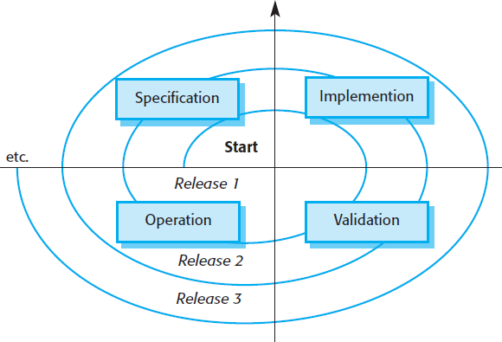
Spiral model of development & evolution
Software engineering is a spiral process with requirements, design, implementation, and testing going on through the lifetime of the system:
You start by creating Release 1 of the system. Once delivered, changes are proposed, and the development of Release 2 starts.
The need for evolution may become obvious even before the system is deployed, so later releases of the software may start development before the current version has even been released.

Slide 7
Spiral model of development & evolution
The spiral model is applicable when the same company is responsible for the software throughout its lifetime:
There is a seamless transition from development to evolution, and the same software development methods and processes are applied throughout the lifetime of the software. Software products and apps are developed using this approach.
Custom or bespoke software usually follows a different evolution model.

Slide 8
Software maintenance
The evolution of custom or bespoke software, however, usually follows a different model:
The system customer may pay a software company to develop the software and then take over responsibility for support and evolution using its own staff.
Alternatively, the software customer might issue a separate contract to a different software company for system support and evolution.
In this situation, there are likely to be discontinuities in the evolution process:
Requirements and design documents may not be passed from one company to another.
Companies may merge or reorganise, inherit software from other companies, and then find that this has to be changed.
When the transition from development to evolution is not seamless, the process of changing the software after delivery is called software maintenance.

Slide 9
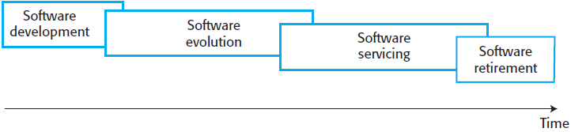
Alternative view of the software evolution cycle
The software development and software evolution phases are distinct:
Software evolution is the phase in which significant changes to the software architecture and functionality are made.
Software development is the phase in which the only changes that are made are relatively small but essential.
The software development and software evolution phases overlap each other.
Eventually, the software is retired and taken out of use.

Slide 10
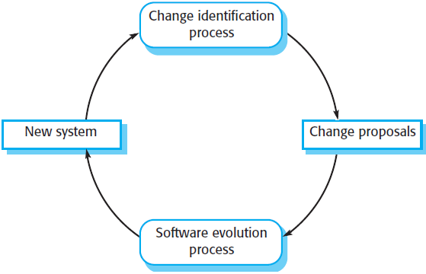
Software evolution processes
Formal or informal system change proposals are the driver for system evolution in all organisations. In a change proposal, an individual or group suggests changes and updates to an existing software system. These proposals may be based on the following:
Existing requirements that have not been implemented in the released system.
Requests for new requirements.
Bug reports from system stakeholders.
New ideas for software improvement.

Slide 11
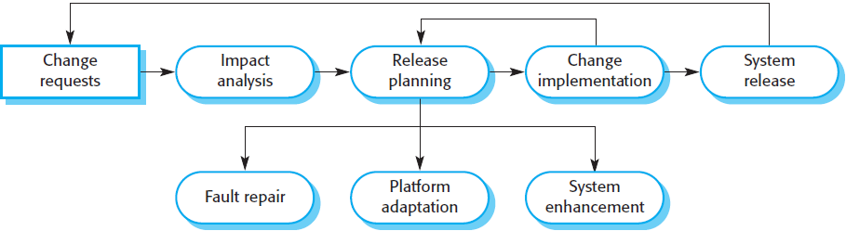
A software evolution process model
The process includes change analysis, release planning, system implementation, and releasing a system to customers. The cost and impact of these changes are assessed to see how much of the system is affected by the change and how much it might cost to implement the change.

Slide 12
A software evolution process model
If the proposed changes are accepted, a new release of the system is planned. During release planning, all proposed changes are considered. A decision is made on which changes to implement in the next version of the system. The changes are implemented and validated, and a new version of the system is released. The process then iterates with a new set of changes proposed for the next release.

Slide 13
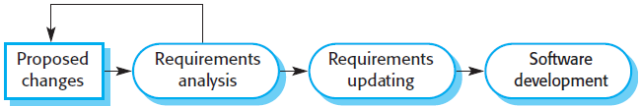
Change implementation
The requirements specification and design documents should be updated to reflect the changes that are required. New software requirements should be written, and these should be analysed and validated. If the design has been documented using UML models, these models should be updated. The proposed changes may be prototyped as part of the change analysis process, where you assess the implications and costs of making the change.

Slide 14
Urgent repairs
Change requests sometimes relate to problems in operational systems that have to be tackled urgently. These urgent changes can arise for three reasons:
If a serious system fault is detected that has to be repaired to allow normal operation to continue or to address a serious security vulnerability.
If changes to the system operating environment have unexpected effects that disrupt normal operation.
If there are unanticipated changes to the business running the system, such as the emergence of new competitors or the introduction of new legislation that affects the system.

Slide 15

Emergency repair process
The need to make the change quickly means that you may not be able to update all of the software documentation. Rather than modify the requirements and design, you make an emergency fix to the program to solve the immediate problem. The danger here is that the requirements, the software design, and the code can become inconsistent. While you may intend to document the change in the requirements and design, additional emergency fixes to the software may then be needed. These take priority over documentation. Eventually, the original change is forgotten, and the system documentation and code are never realigned.

Slide 16
Software evolution in an agile process
Agile methods and processes may be used for program evolution as well as program development. Because these methods are based on incremental development, making the transition from agile development to post-delivery evolution should be seamless. However, problems may arise during the handover from a development team to a separate team responsible for system evolution:
Where the development team has used an agile approach but the evolution team prefers a plan-based approach. The evolution team may expect detailed documentation to support evolution, and this is rarely produced in agile processes.

Slide 17
Software evolution in an agile process
However, problems may arise during the handover from a development team to a separate team responsible for system evolution (cont’d):
Where a plan-based approach has been used for development but the evolution team prefers to use agile methods. In this case, the evolution team may have to start from scratch developing automated tests. The code in the system may not have been refactored and simplified, as is expected in agile development. Some reengineering may be required to improve the code before it can be used in an agile development process.

Slide 18
Legacy systems
Legacy systems are older systems that rely on languages and technology that are no longer used for new systems development. Typically, they have been maintained over a long period, and their structure may have been degraded by the changes that have been made. Legacy software may be dependent on older hardware, such as mainframe computers and may have associated legacy processes and procedures. It may be impossible to change to more effective business processes because the legacy software cannot be modified to support new processes.

Slide 19
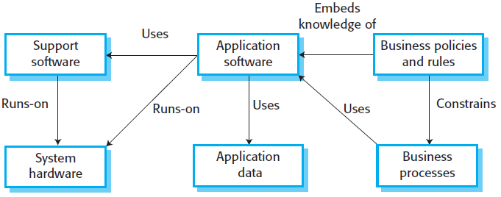
Elements of a legacy system
System hardware:
Legacy systems may have been written for hardware that is no longer available, that is expensive to maintain, and that may not be compatible with current organisational IT purchasing policies.
Support software:
The legacy system may rely on a range of support software from the operating system and utilities provided by the hardware manufacturer through to the compilers used for system development. These may be obsolete and no longer supported by their original providers.

Slide 20
Elements of a legacy system
Application software:
The application system that provides the business services is usually made up of a number of application programs that have been developed at different times. Some of these programs will also be part of other application software systems.
Application data:
These data are processed by the application system. In many legacy systems, an immense volume of data has accumulated over the lifetime of the system. This data may be inconsistent, duplicated, and spread over a number of different databases.

Slide 21
Elements of a legacy system
Business processes:
These processes are used in the business to achieve some business objective. Business processes may be designed around a legacy system and constrained by the functionality that it provides.
Business policies and rules:
These are definitions of how the business should be carried out and contraints on the business. Use of the legacy application system may be embedded in these policies and rules.

Slide 22
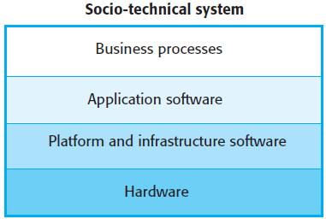
Layers of a legacy system
An alternative way of looking at these components of a legacy system is as a series of layers. Each layer depends on the layer immediately below it and interfaces with that layer. If interfaces are maintained, then you should be able to make changes within a layer without affecting either of the adjacent layers. In practice, this simple encapsulation is an oversimplification, and changes to one layer of the system may require consequent changes to layers that are both above and below the changed level.

Slide 23
Layers of a legacy system
Changing one layer in the system may introduce new facilities, and higher layers in the system may then be changed to take advantage of these facilities.
Changing the software may slow the system down so that new hardware is needed to improve system performance. The increase in performance from the new hardware may then mean that further software changes that were previously impractical become possible.
It is often impossible to maintain hardware interfaces, especially if new hardware is introduced.

Slide 24
Challenges in maintaining legacy systems
It is difficult to know exactly how much legacy code is still in use. As an example, industry has estimated that there are more than 200 billion lines of COBOL code in current business systems. COBOL is a programming language designed for writing business systems, and widely used in the finance industry.
Shortage of COBOL programmers as the original developers of the system retire. Universities no longer teach COBOL and younger software engineers are more interested in programming in modern languages.
Other issues include security vulnerabilities, problems in interfacing with systems written in modern programming languages. The original software tool supplier may be out of business or may no longer maintain the support tools used to develop the system.

Slide 25
Risks of replacing legacy systems
There is rarely a complete specification of the legacy system. The original specification may have been lost. If a specification exists, it is unlikely that it has been updated with all of the system changes that have been made.
Business processes and the ways in which legacy systems operate are often intertwined. These processes are likely to have evolved to take advantage of the software’s services and to work around the software’s shortcomings. If the system is replaced, these processes have to change with potentially unpredictable costs and consequences.

Slide 26
Risks of replacing legacy systems
Important business rules may be embedded in the software and may not be documented elsewhere. A business rule is a constraint that applies to some business function, and breaking that constraint can have unpredictable consequences for the business. If these rules are not maintained, the company may accept high-risk policies that could result in expensive future claims.
New software development is inherently risky, so that there may be unexpected problems with a new system. It may not be delivered on time and for the price expected.

Slide 27
Costs of changing a legacy system
The program style and usage conventions are inconsistent because different people have been responsible for system changes.
Part or all of the system may be implemented using obsolete programming languages. It may be difficult to find people who have knowledge of these languages.
System documentation is often inadequate and out of date. In some cases, the only documentation is the system source code.
Many years of maintenance usually degrades the system structure, making it increasingly difficult to understand.

Slide 28
Costs of changing a legacy system
The system may have been optimised for space utilisation or execution speed so that it runs effectively on older slower software. This normally involves using specific machine and language optimisations, and these usually lead to software that is hard to understand. This causes problems for programmers who have learned modern software engineering techniques and who don’t understand the programming tricks that have been used to optimise the software.
The data processed by the system may be maintained in different files that have incompatible structures. There may be data duplication, and the data itself may be out of date, inaccurate, and incomplete.

Slide 29
Legacy system management
Many organisations have a limited budget for maintaining and upgrading their portfolio of legacy systems. They have to decide how to get the best return on their investment. This involves making a realistic assessment of their legacy systems and then deciding on the most appropriate strategy for evolving these systems. There are four strategic options:
Scrap the system completely. This option should be chosen when the system is not making an effective contribution to business processes.
Leave the system unchanged and continue with regular maintenance. This option should be chosen when the system is still required but is fairly stable and the system users make relatively few change requests.

Slide 30
Legacy system management
There are four strategic options (cont’d):
Reengineer the system to improve its maintainability. This option should be chosen when the system quality has been degraded by change and where new change to the system is still being proposed.
Replace all or part of the system with a new system. This option should be chosen when factors, such as new hardware, mean that the old system cannot continue in operation, or where off-the-shelf systems would allow the new system to be developed at a reasonable cost.

Slide 31
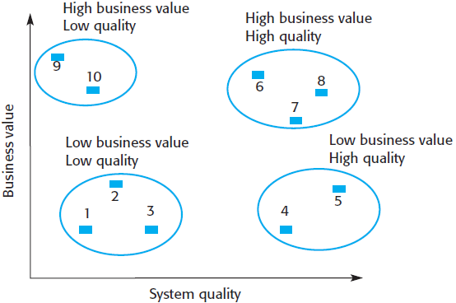
Legacy system assessment
A chart can be used to show the relative business value and system quality of a legacy system:
Low quality, low business value. Keeping these systems in operation will be expensive, and the rate of return to the business will be fairly small. These systems should be scrapped.
Low quality, high business value. These systems are making an important business contribution, so they cannot be scrapped. However, their low quality means that they are expensive to maintain. These systems should be reengineered to improve their quality, or replaced if suitable COTS are available.

Slide 32
Legacy system assessment
A chart can be used to show the relative business value and system quality of a legacy system (cont’d):
High quality, low business value. These systems don’t contribute much to the business but may not be expensive to maintain. It is not worth replacing these systems, so normal system maintenance may be continued if expensive changes are not required and the system hardware remains in use.
High quality, high business value. These systems have to be kept in operation. However, their high quality means that you don’t have to invest in transformation or system replacement. Normal system maintenance should be continued.

Slide 33
Legacy system business value
The business value of a legacy system is a measure of how much time and effort the system saves compared to manual processes or the use of other systems. There are four basic issues that you have to discuss:
The use of the system. If a system is only used occasionally or by a small number of people, this may mean that it has a low business value.
The business processes that are supported. When a system is introduced, business processes are usually introduced to exploit the system’s capabilities. If the system is inflexible, changing these business processes may be impossible. As the environment changes, the original business processes may become obsolete. Thus, a system may have a low business value because it forces the use of inefficient business processes.

Slide 34
Legacy system business value
There are four basic issues that you have to discuss (cont’d):
System dependability. System dependability is not only a technical problem but also a business problem. If a system is not dependable and the problems directly affect business customers, or mean that people in the business are diverted from other tasks to solve these problems, the system has a low business value.
The system outputs. The key issue here is the importance of the system outputs to the successful functioning of the business. If the business depends on these outputs, then the system has a high business value. Conversely, if these outputs can be cheaply generated in some other way, or if the system produces outputs that are rarely used, then the system has a low business value.

Slide 35
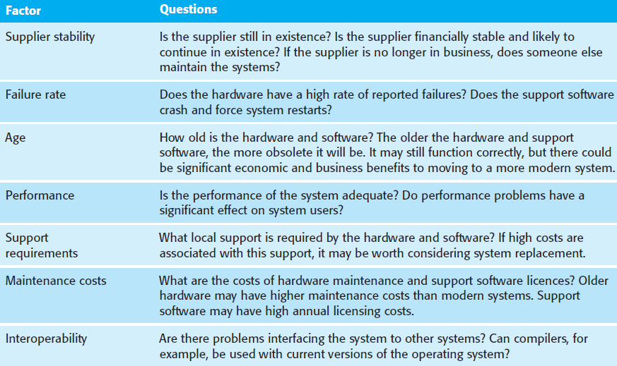
Legacy system quality value
Factors used in environment assessment.

Slide 36
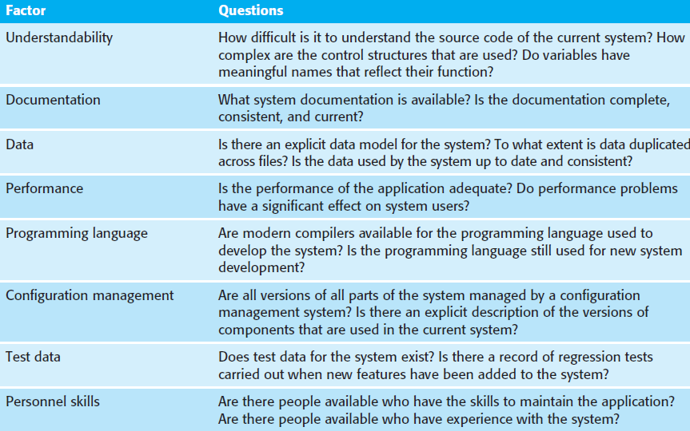
Legacy system quality value
Factors used in application assessment.

Slide 37
Software maintenance
Software maintenance is the general process of changing a system after it has been delivered. The term is usually applied to custom or bespoke software, where separate development groups are involved before and after delivery. The changes made to the software may be simple changes to correct coding errors, more extensive changes to correct design errors, or significant enhancements to correct specification errors or to accommodate new requirements. Changes are implemented by modifying existing system components, and where necessary, by adding new components to the system.

Slide 38
Types of software maintenance
There are 3 different types of software maintenance:
Fault repairs to fix bugs and vulnerabilities. Coding errors are usually relatively cheap to correct. Design errors are more expensive because they may involve rewriting several program components. Requirements errors are the most expensive to repair because extensive system redesign may be necessary.
Environmental adaptation to adapt the software to new platforms and environments. This type of maintenance is required when some aspect of a system’s environment, such as the hardware, the operating system, or other support software, changes.
Functionality addition to add new features and to support new requirements. This type of maintenance is necessary when system requirements change in respond to organisational or business change. The scale of the changes required to the software is often much greater than for other types of maintenance.

Slide 39
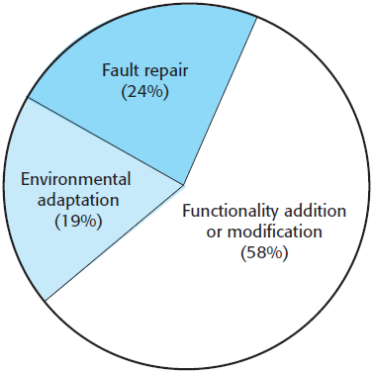
Maintenance distribution effort
Experience has shown that it is usually more expensive to add new features to a system during maintenance than it is to implement the same features during initial development:
A new team has to understand the program being maintained.
Separating maintenance and development means there is no incentive for the development team to write maintainable software.
Program maintenance work is unpopular. Maintenance has a poor image among software engineers. It is seen as a less skilled process than system development and is often allocated to the least experienced staff.

Slide 40
Maintenance distribution effort
Experience has shown that it is usually more expensive to add new features to a system during maintenance than it is to implement the same features during initial development (cont’d):
As programs age, their structure degrades and they become harder to change. As changes are made to programs, their structure tends to degrade. Consequently, they become harder to understand and change. Some systems have been developed without modern software engineering techniques. They may never have been well structured and were optimised for efficiency rather than understanding. System documentation may be lost or inconsistent. Old systems may not have been subject to stringent configuration management, so developers have to spend time finding the right versions of system components to change.

Slide 41
Maintenance prediction
Maintenance prediction is concerned with trying to assess the changes that may be required in a software system and with identifying those parts of the system that are likely to be the most expensive to change.
Predicting the number of change requests for a system requires an understanding of the relationship between the system and its external environment. Some systems have a very complex relationship with their external environment, and changes to that environment inevitably result in changes to the system.

Slide 42
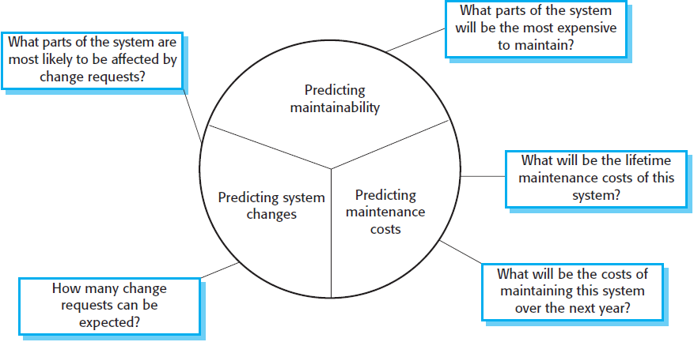
Maintenance prediction

Slide 43
Maintenance prediction
To evaluate the relationship between a system and its environment, you should look at:
The number and complexity of system interfaces. The larger the number of interfaces and the more complex these interfaces, the more likely it is that interface changes will be required as new requirements are proposed.
The number of inherently volatile system requirements. Requirements that reflect organisational policies and procedures are likely to be more volatile than requirements that are based on stable domain characteristics.
The business processes in which the system is used. As business processes evolve, they generate system change requests. As a system is integrated with more and more business processes, there are increased demands for changes.

Slide 44
Metrics for assessing maintainability
After a system has been put into service, you may be able to use process data to help predict maintainability. Examples of process metrics that can be used for assessing maintainability are:
Number of requests for corrective maintenance. An increase in the number of bug and failure reports may indicate that more errors are being introduced into the program than are being repaired during the maintenance process.
Average time required for impact analysis. This is related to the number of program components that are affected by the change request. If the time required for impact analysis increases, it implies that more and more components are affected and maintainability is decreasing.

Slide 45
Metrics for assessing maintainability
Examples of process metrics that can be used for assessing maintainability are (cont’d):
Average time taken to implement a change request. This is not the same as the time for impact analysis although it may correlate with it. This is the amount of time that you need to modify the system and its documentation, after you have assessed which components are affected. An increase in the time needed to implement a change may indicate a decline in maintainability.
Number of outstanding change requests. An increase in this number over time may imply a decline in maintainability.

Slide 46
Software reengineering
Software maintenance involves understanding the program that has to be changed and then implementing any required changes. However, many systems, especially older legacy systems, are difficult to understand and change. The programs may have been optimised for performance or space utilisation at the expense of understandability, or, over time, the initial program may have been corrupted by a series of changes.
To make legacy software systems easier to maintain, you can reengineer these systems to improve their structure and understandability. Reengineering may involve redocumenting the system, refactoring the system architecture, translating programs to a modern programming language, or modifying and updating the structure and values of the system’s data.

Slide 47
Advantages of software reengineering
Reengineering has two important advantages over replacement:
Reduced risk. There is a high risk in redeveloping business-critical software. Errors may be made in the system specification or there may be development problems. Delays in introducing the new software may mean that business is lost and extra costs are incurred.
Reduced cost. The cost of reengineering may be significantly less than the cost of developing new software.

Slide 48
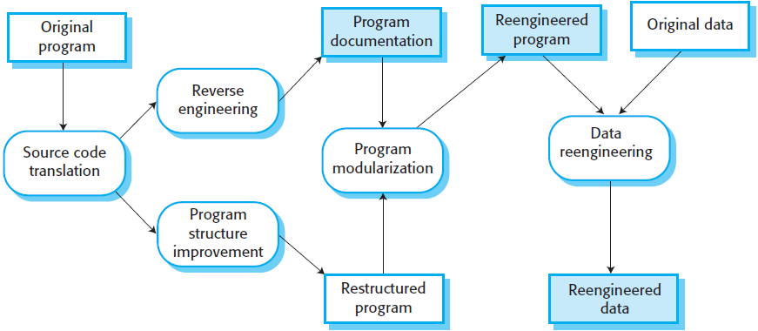
The reengineering process
Source code translation:
Using a translation tool, you can convert the program from an old programming language to a more modern version of the same language or to a different language.
Reverse engineering:
The program is analysed and information extracted from it. This helps to document its organisation and functionality.

Slide 49
The reengineering process
Program structure improvement:
The control structure of the program is analysed and modified to make it easier to read and understand. This can be partially automated, but some manual intervention is usually required.
Program modularisation:
Related parts of the program are grouped together, and, where appropriate, redundancy is removed. This is a manual process.

Slide 50
The reengineering process
Data reengineering:
The data processed by the program is changed to reflect program changes. This may mean redefining database schemas and converting existing databases to the new structure.
The data should also be cleaned up. This involves finding and correcting mistakes, removing duplicate records, etc. This can be a very expensive and prolonged process.

Slide 51
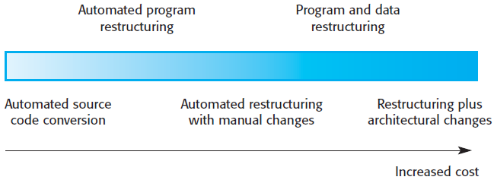
Reengineering approaches
The costs of reengineering depends on the extent of the work that is carried out. Costs increase from left to right so that source code translation is the cheapest option, and reengineering, as part of architectural migration, is the most expensive.

Slide 52
Refactoring
Refactoring is the process of making improvements to a program to slow down degradation through change. It means modifying a program to improve its structure, reduce its complexity, or make it easier to understand. When you refactor a program, you should not add functionality but rather should concentrate on program improvement.
Although reengineering and refactoring are both intended to make software easier to understand and change, they are not the same thing:
Reengineering takes place after a system has been maintained for some time, and maintenance costs are increasing. In contrast, refactoring is a continuous process of improvement throughout the development and evolution process. It is intended to avoid the structure and code degradation that increases the costs and difficulties of maintaining a system.

Slide 53
“Bad smells”
There are stereotypical situations where the code of a program can be improved. Some examples include:
Duplicate code. The same or very similar code may be included at different places in a program. This can be removed and implemented as a single method or function that is called as required.
Long methods. If a method is too long, it should be redesigned as a number of shorter methods.
Switch statements. These often involve duplication, where the switch depends on the type of a value. The switch statements may be scattered around a program. In an OO language, you can use polymorphism to achieve the same thing.

Slide 54
“Bad smells”
There are stereotypical situations where the code of a program can be improved. Some examples include (cont’d):
Data clumping. Data clumps occur when the same group of data items reoccurs in several places in a program. These can often be replaced with an object that encapsulates all of the data.
Speculative generality. This occurs when developers include generality in a program in case it is required in the future. This can often be simply removed.

Slide 55
Lessons learned
Software development and evolution can be thought of as an integrated, iterative process that can be represented using a spiral model.
For custom systems, the costs of software maintenance usually exceed the software development costs.
The process of software evolution is driven by requests for changes and includes change impact analysis, release planning, and change implementation.
It is often cheaper and less risky to maintain a legacy system than to develop a replacement system using modern technology.

Slide 56
Lessons learned
The business value of a legacy system and the quality of the application software and its environment should be assessed to determine whether a system should be replaced, transformed, or maintained.
There are three types of software maintenance, namely, bug fixing, modifying software to work in a new environment, and implementing new or changed requirements.
Software reengineering is concerned with restructuring and redocumenting software to make it easier to understand and change.

